Slide 1


SAP S/4HANA Training
MASTER DATA GOVERNANCE (SAP MDG)
Neeraj Gupta
Session 14
SAP MDG – Workflow Process Modelling

Slide 2
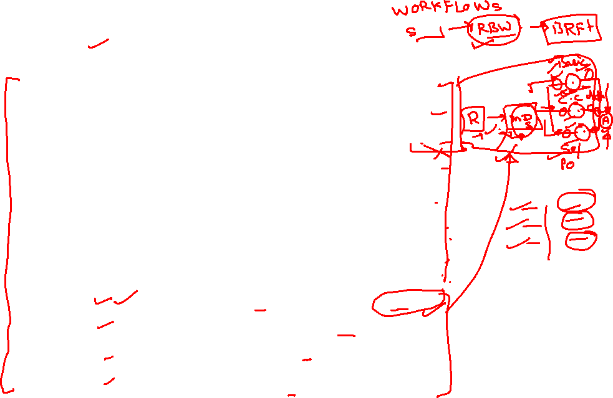
Event type Linkage Activation
14
SAP MDG – Workflow Process Modelling

Slide 3
Standard Workflow Templates
14
SAP MDG – Workflow Process Modelling

Slide 4
Template Workflows in Standard SAP MDG Processes
14
SAP MDG – Workflow Process Modelling
MM & BP : WS60800086 (RBW)
BP Hierarchy & Mass maintenance : WS60800095
BP Initial Load : WS72100006
SUPPLIER Create Process : WS54300005
Financials (OG) Simple: WS75700040 –
- Execution and approval of changes at change request level
Financials (OG) Advanced : WS75700027 -
- Execution and approval of changes at individual object level
Financials (OG) Extended : WS75700043 –
- Execution and approval of changes at individual object level and allows control of steps by entity types

Slide 5
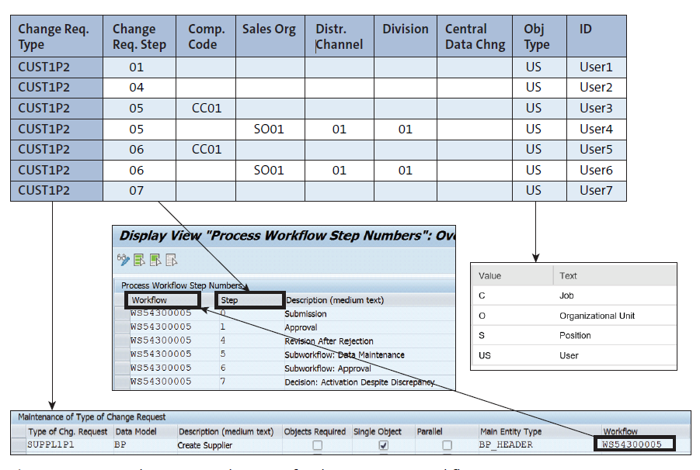
Example: Agent assignment for the customer workflow
14
SAP MDG – Workflow Process Modelling

Slide 6
Business add-ins: (RBW)
14
SAP MDG – Using Rule Based Workflow (WS60800086)

Slide 7
Business add-ins: (RBW) BAdI USMD_SSW_RULE_CONTEXT_PREPARE method PREPARE_RULE_CONTEXT Scenario: The function of this rule context BAdI is to route that CR at a certain step to specific user/group/role
14
SAP MDG – Using Rule Based Workflow (WS60800086)
Create a Change Request Procedure

Slide 8
Business add-ins: (RBW) BAdI USMD_SSW_DYNAMIC_AGENT_SELECT method GET_DYNAMIC_AGENTS Scenario: The user agent decision table determines the agents. The customer requirement is to have a more flexible user determination de-pendent on own coding.
14
SAP MDG – Using Rule Based Workflow (WS60800086)
Create change request type

Slide 9
Business add-ins: (RBW) BAdI USMD_SSW_PARA_RESULT_HANDLER method HANDLE_PARALLEL_RESULT Scenario: Handle and merge the results of the parallel workflows into one result. Account approval process using the decision tables of the rule-based workflow and create parallel approval workflow steps when the parallel number is determined dynamically.
14
SAP MDG – Using Rule Based Workflow (WS60800086)
Create new Change Request Type

Slide 10
Business add-ins: (RBW) BAdI USMD_SSW_SYSTEM_METHOD_CALLER method CALL_SYSTEM_METHOD Scenario: Handle and merge the results of the parallel workflows into one result. Account approval process using the decision tables of the rule-based workflow and create parallel approval workflow steps when the parallel number is determined dynamically.
14
SAP MDG – Using Rule Based Workflow (WS60800086)
Create Enhancement Implementation >> USMD_SSW_SYSTEM_METHOD_CALLER

Slide 11

End of Session 14

Slide 12

Questions

Slide 13

Neeraj gupta

Slide 14


We’re committed to empower you to be
Most Desirable Resource
through powerful training solutions.
We build the workforce of the future.
250+
Corporate Clients
30,000+
Learners Trained
25000+
Learners Placed
FREE WEBINARS
Sign up for free webinars with industry experts every fortnight!
Enroll Now!
Contact us today!
https://anubhavtrainings.com/

Slide 15




More from AnubhavTrainings.com

